Slide 1
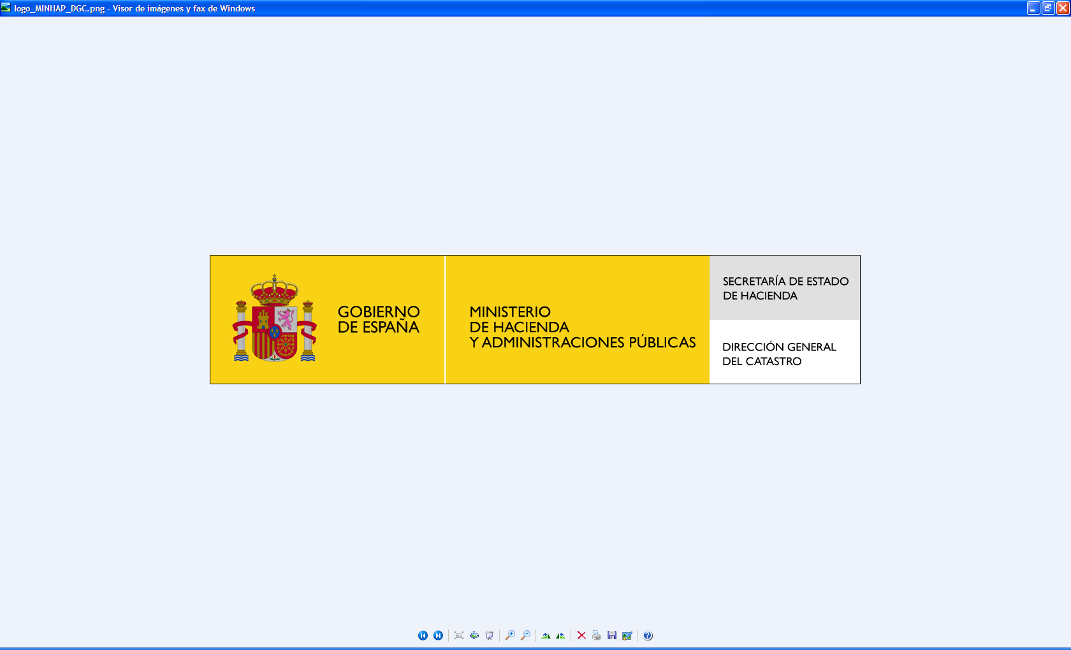
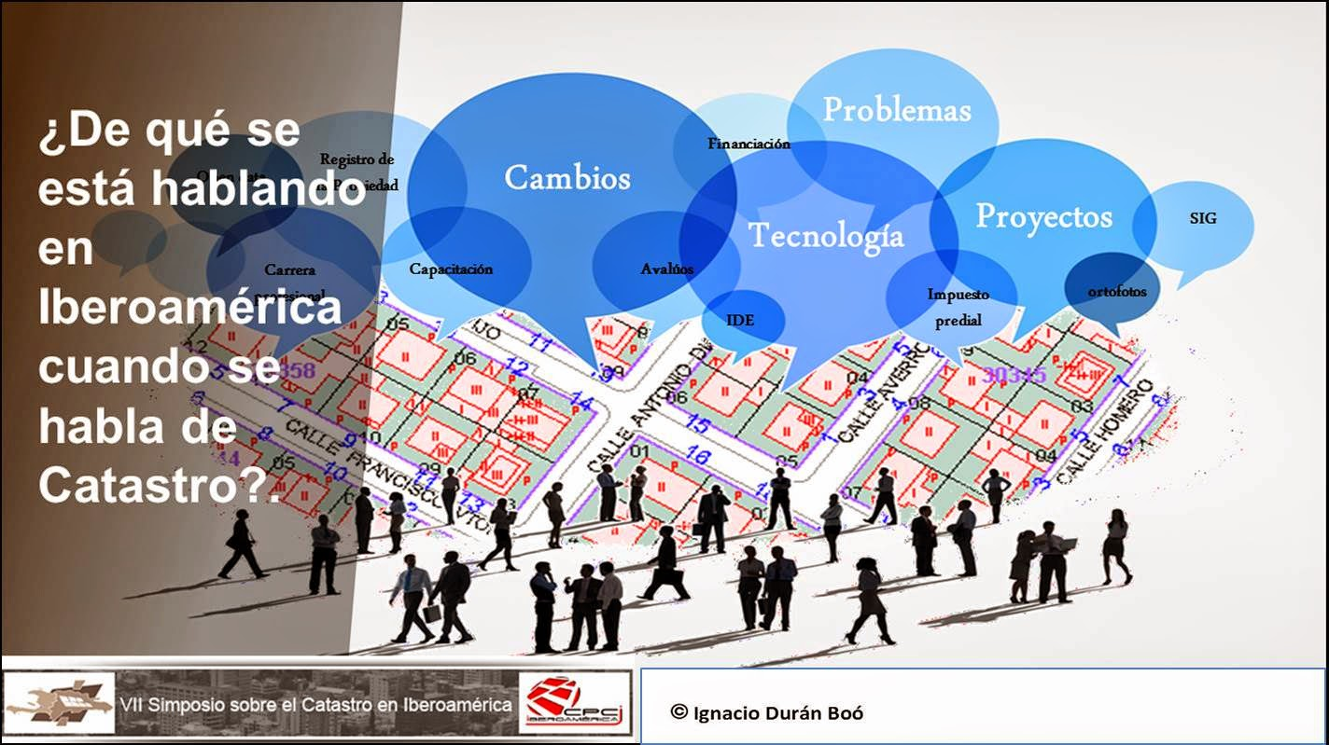
Cadastral Regularization Plan 2013-2017
Amalia Velasco
Spanish Directorate General for Cadastre

Slide 2
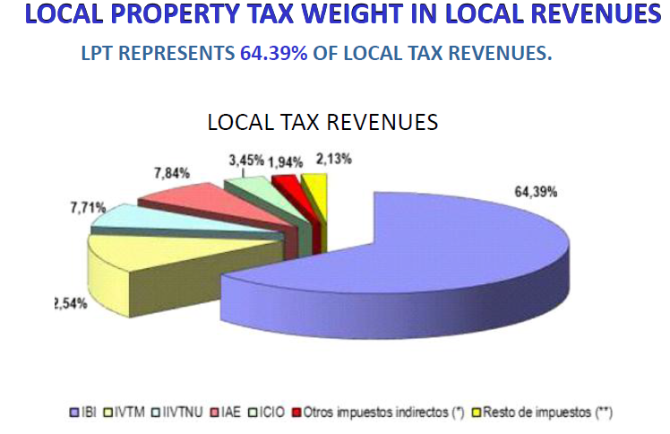
Recurrent local property tax is the main income for the 7.595 Spanish municipalities
Recurrent local property tax is calculate from the Cadastral Value for each property.
Spanish Directorate General for cadastre is responsible to asses the Cadastral Values.

Slide 3
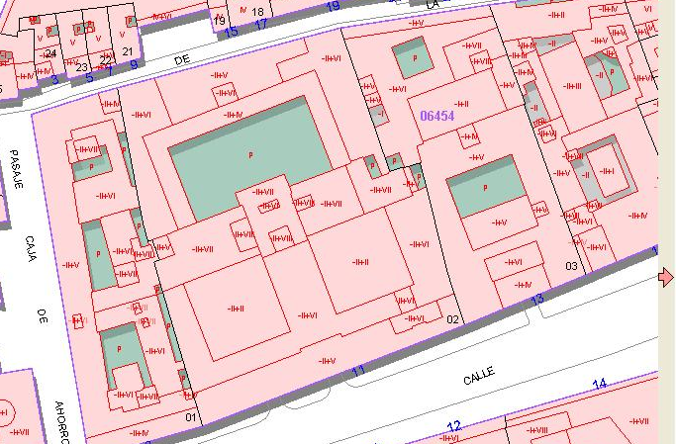
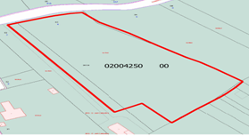
The cadastral value for each property is determined objectively from the data in the Real Estate Cadastre.
      Physical data of real estate:
        land surface,
        buildings surface,
        conservation status,
        use (legal and actual one),
        typology,
        year of construction…..

Slide 4


Methodology for the valuation
The selection of a methodology was determined by law
the cadastral value must comply with the following basic
requisites:
it must be fair,
objective,
directly related to the market
and calculated from the cadastral data .
The cadastral value is composed
of the value of the land +
the value of the buildings

Slide 5
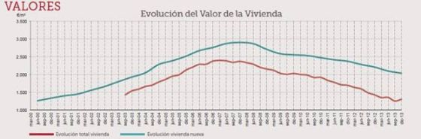
What happens in crisis periods?
Values of the properties go down
New
All

Slide 6
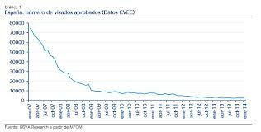
What happens in crisis periods?
The construction activity also goes down
Less Cadastral Activity
Less work for the Companies that work for cadastre

Slide 7
What happens in crisis periods?
Incomes of the municipalities.

Slide 8

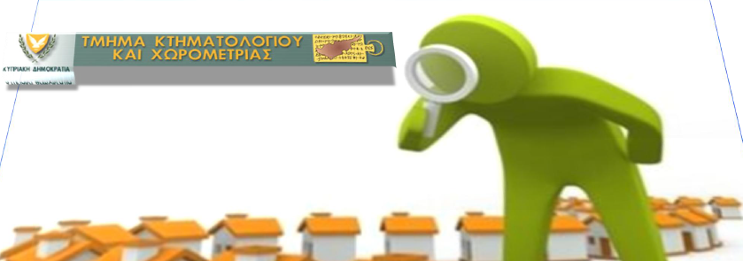
Increase of property tax face strong resistance in crisis periods.
Our only way to improve the financial situation of municipalities is increase the Cadastral Inspection system to ensure that everybody pays the adequate amount.
But normal legal inspection proceedings are complicated and slow

Slide 9
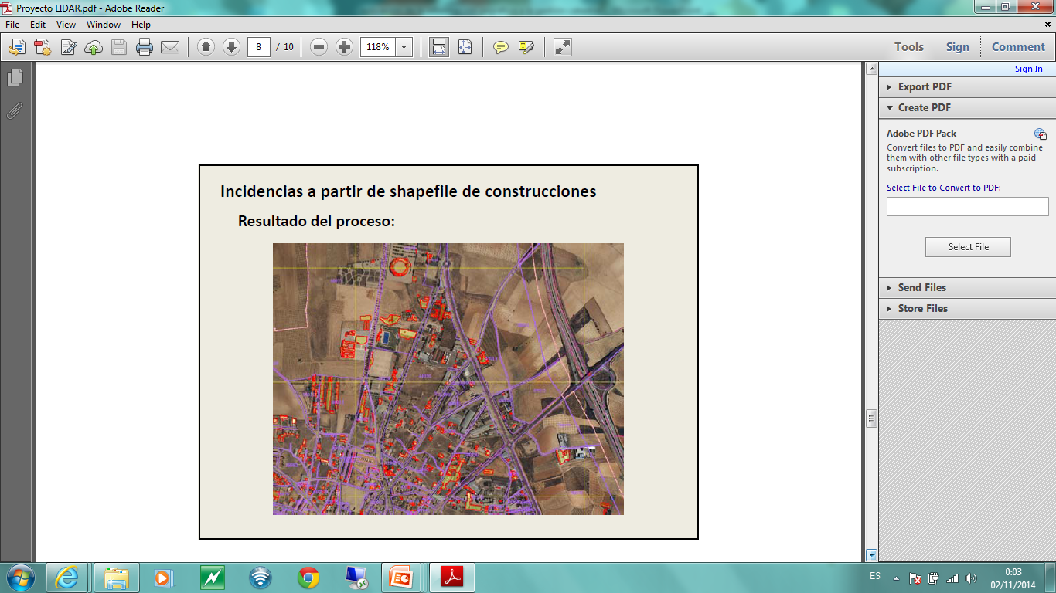
And on the other hand, now a days ,
the technical level of the Spanish Cadastre
and the technological developments
allow us to demonstrate the existence of
a certain grade omissions of constructions
and undeclared alterations (extensions, reforms, renovations changes of use ),
.

Slide 10

Cadastral Regulation Plan
plan specially designed,
of validity limited to five years,
with easy implantation in the whole territory,
Self-financed,
and of agile, effective and efficient procedure

Slide 11
The Spanish General Directorate for Cadastre, following the strategic policy of the Ministry of Finance and Public Administration, launched in 2013 this ambitious plan aimed to combat real estate tax fraud and to boost local finance
It was necessary to made modifications of the legal regulations
New legal procedure:
cadastral regularization procedure 2013-2017

Slide 12
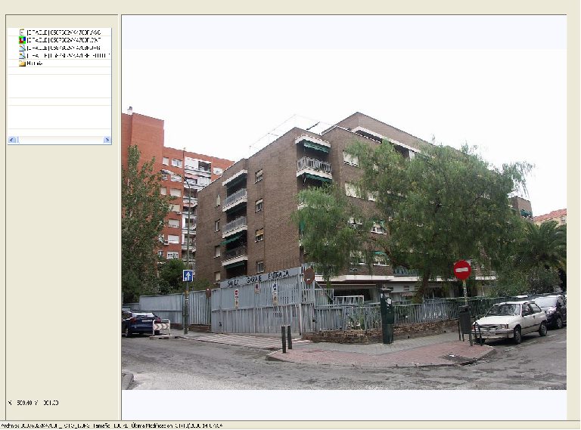
New legal procedure:
cadastral regularization procedure 2013-2017
This procedure, has the objective to incorporate to the cadastre
the omitted construction
and undeclared alterations
extensions,
reforms
renovations
change of use ..etc
and to assign them their corresponding cadastral value ,
so that the owner pays the tax in concordance with the reality
and that the municipalities can obtain the necessary incomes

Slide 13
The target of the plan is that the property description of the real estate affected agrees with the reality.
In Spain the declaration to the cadastre is obligatory by law and also the alterations of its characteristics
but in cases of non-compliance with the obligation to declare
the regularization procedure allows us to update in the Cadastre all the information necessary to describe the real estate and to can obtain the cadastral value

Slide 14
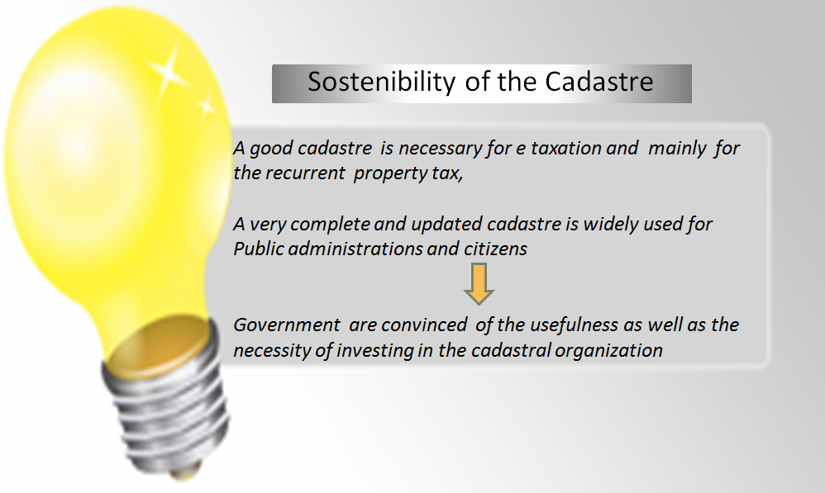
To get this objective, for each year, the Ministry of Finance has allocated 40 million Euros to the Spanish Cadastre budget

Slide 15

Nevertheless, the circumstances and the economic situation of Spain in the moment force an essential requisite
The development of the property regularization plan must be
Financial self-sufficient in its execution
Without implying any cost for the municipalities
cadastral regulation fee
The invest money of the government will be recovered through a cadastral regulation fee that will be charged to taxpayers who are regulated by this proceeding.

Slide 16
New legal procedure:
cadastral regularization procedure 2013-2017
5 years project
EFFECTS in the incomes of municipalities:
additional income (in the future)
and recovery of arrears of up to 4 years
    and other local taxes, as the municipal capital gains, that are also based in the Cadastral Value, will be also raised

Slide 17
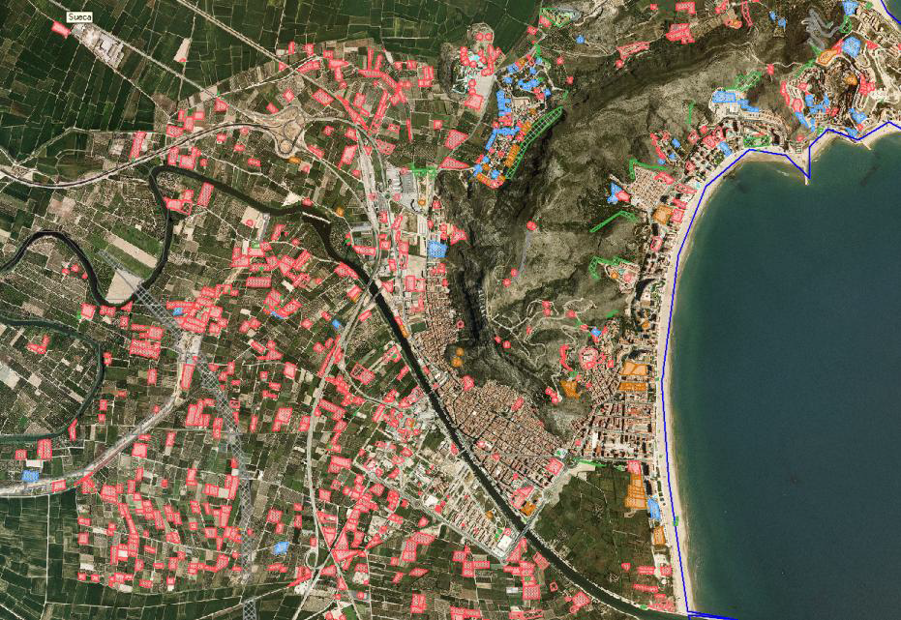
We detected omitted constructions, rehabilitations, additions and other alterations, from
aerial photographs,
(Historic series)
LIDAR,
photographs of façade for
all the buildings of a municipality,
oblique photographs
and additional work and field work.
Very good tools has been implemented to integrate these information with our database and documentation, to be able to manage the proceeding

Slide 18
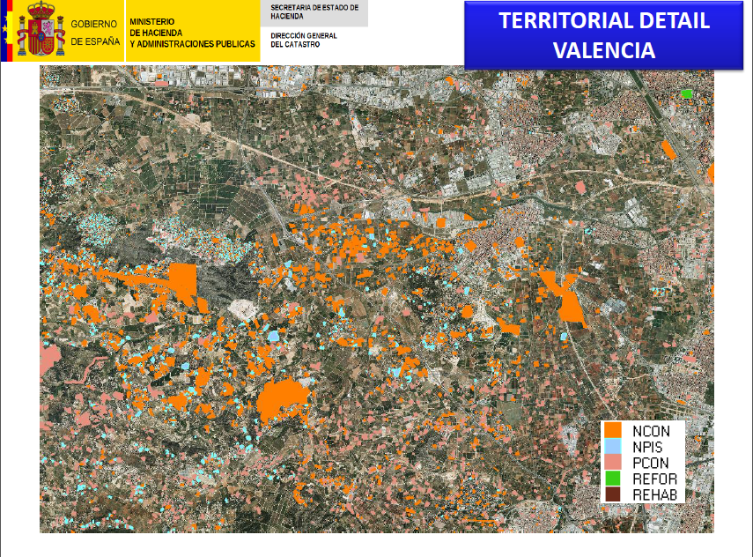
Detection of incidences is a technical work that is realized by the civil servants of the territorial offices

Slide 19

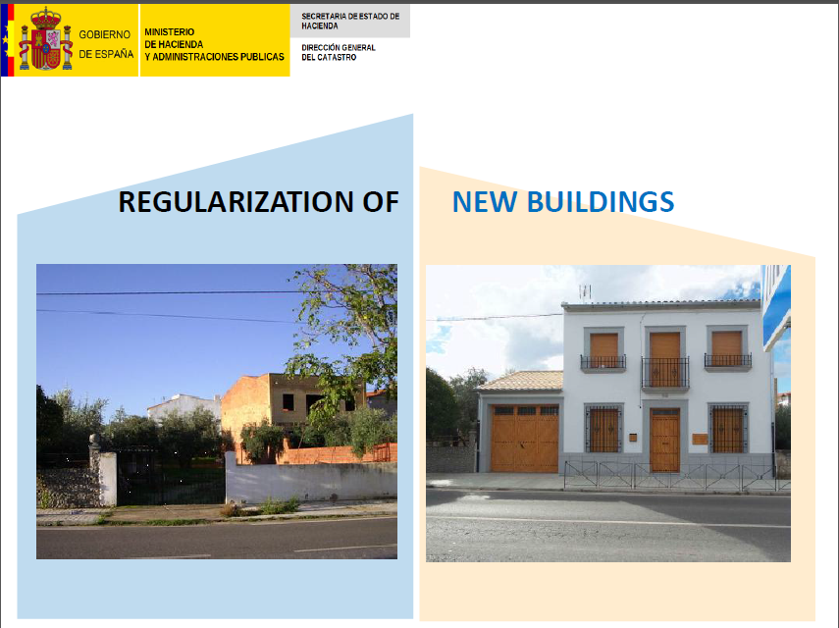

Slide 20
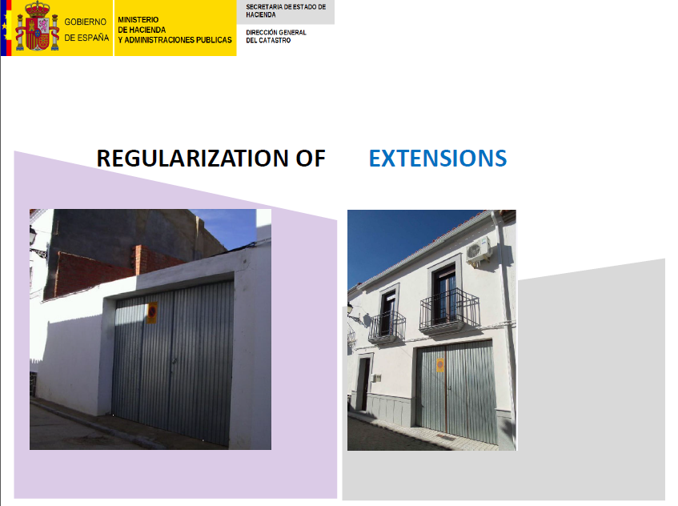

Slide 21
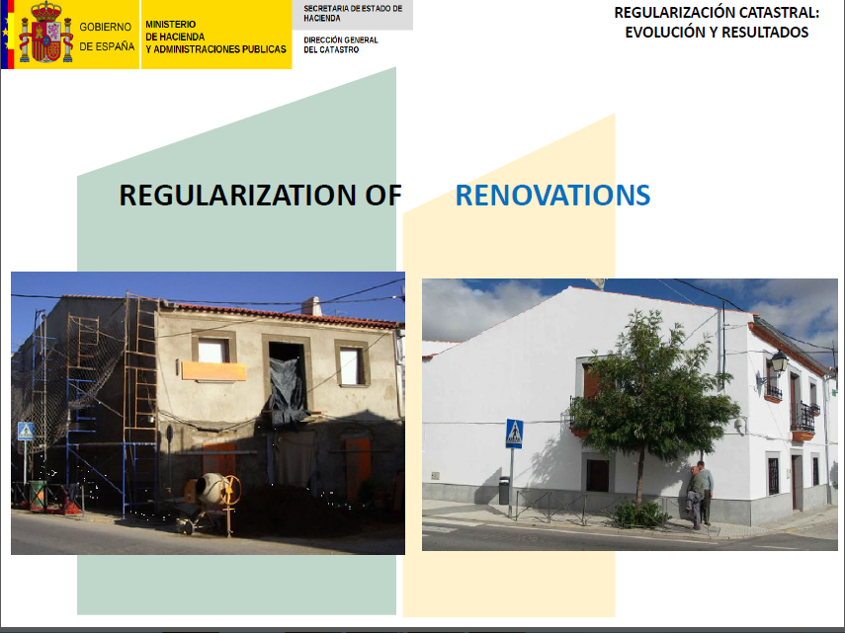

Slide 22
The biggest project never done by Spanish Cadastre
Complex planification and execution
8 municipalities, 44.000 urban real estates and 47.595 rural cadastral parcels a day
      Homogenization of criteria, instructions, coordination etc…..by the central office of the cadastre
      Responsibility of the work ………by Instrumental Company of the Spanish Government. SEGIPSA
      Field works ….. by the local/regional/national 119 private companies homologated by SEGIPSA
      Detection of discrepancies and quality control of the results, resolution of allegations and appealing …….by territorial offices
PPP
Public-private partenship

Slide 23
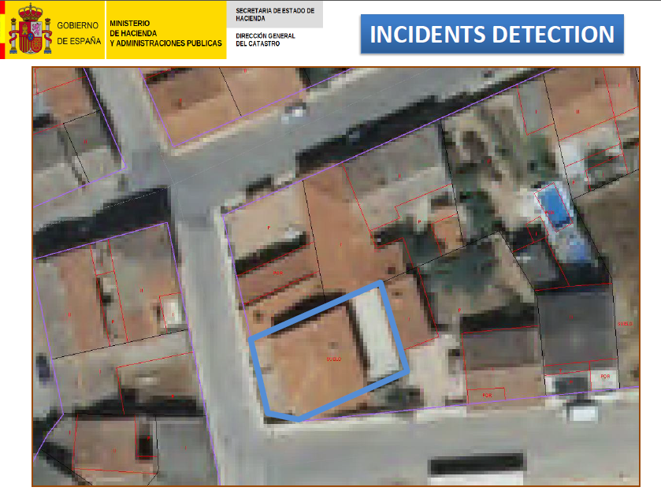

Slide 24
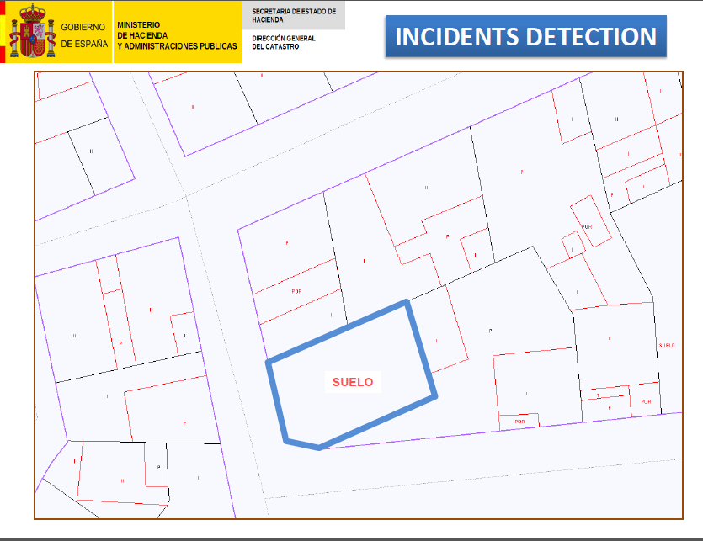

Slide 25
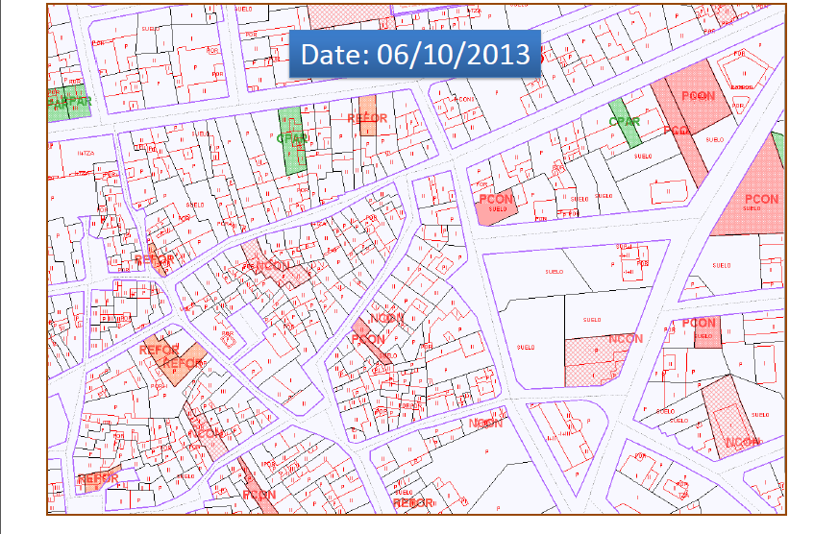
We included it, with the others of the same municipality, in a regularization process in 2013

Slide 26
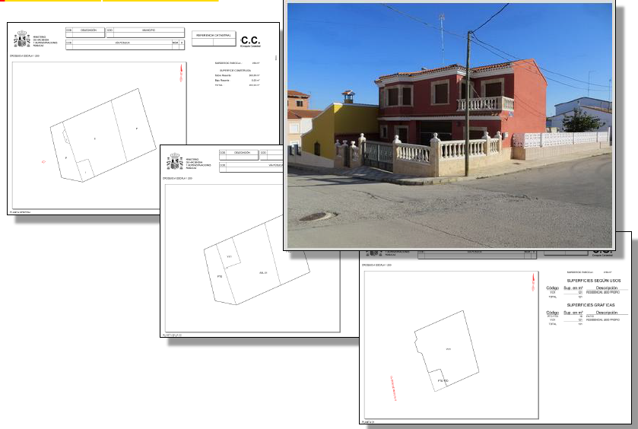
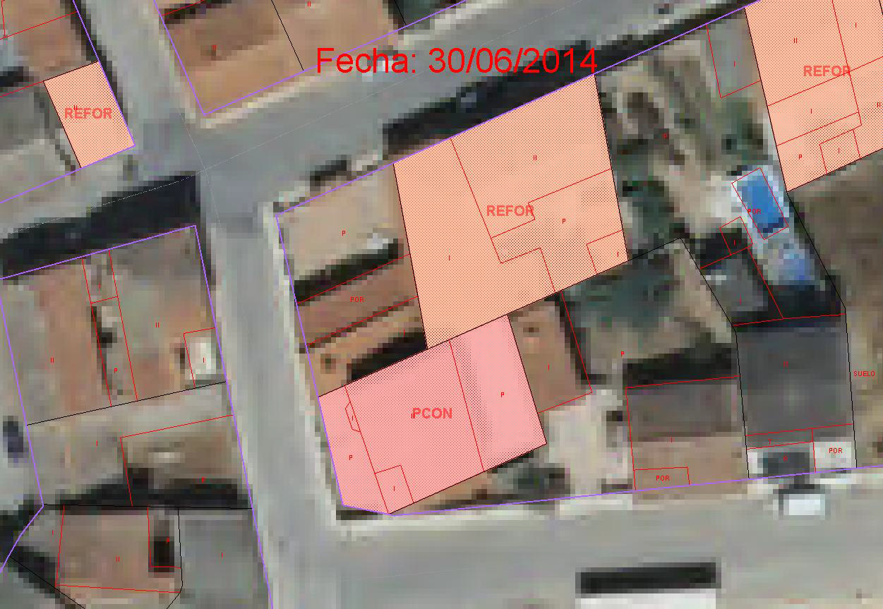
We contract external companies to do the field work and to incorporate the data to our system
The technicians of the head and territorial offices check the quality of the work

Slide 27
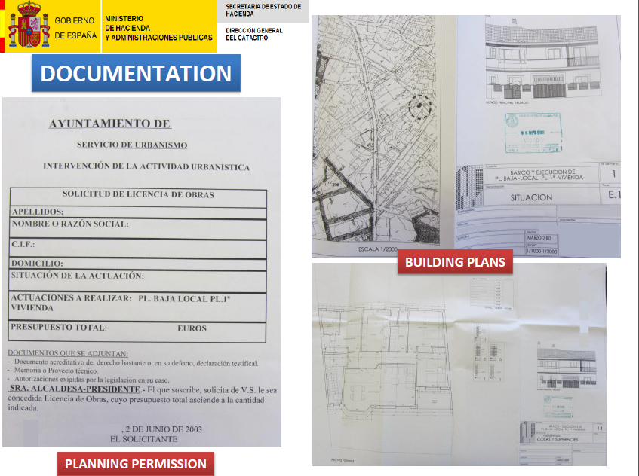

Slide 28
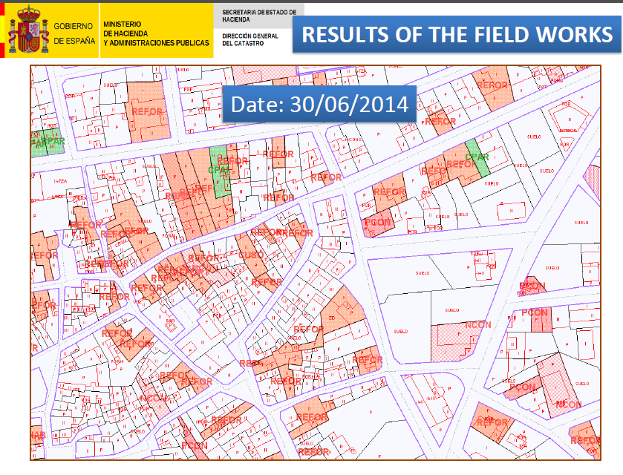

Slide 29
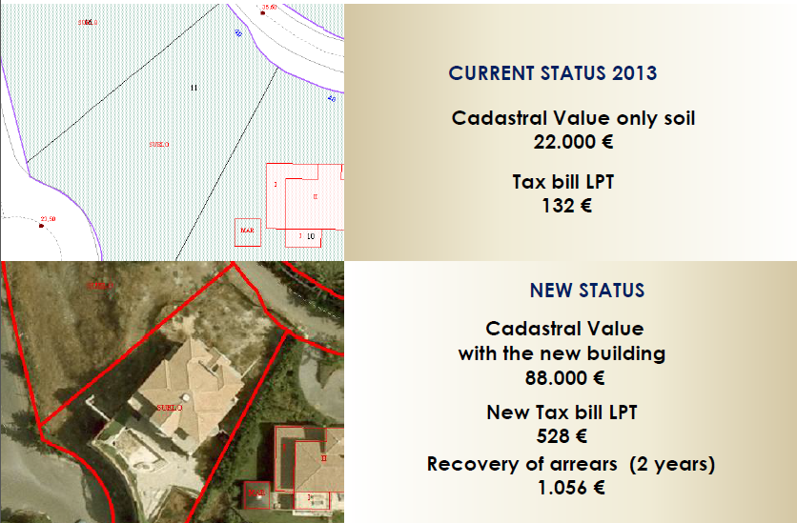
Another example with calculation of cadastral value and recurrent local property tax
Status 2013
New Status

Slide 30
Administrative Proceeding
Communication of the beginning of the procedure and allegation period.
to owner
if it is necessary to neighbors
Regularization fee that it is liquidate at the end
may be it is necessary to practice requirements (under the duty of cooperation and punish its lack of attention )
1
the allegations are studied and, if it is the case, they will be sent back to the company that performs the work

Slide 31
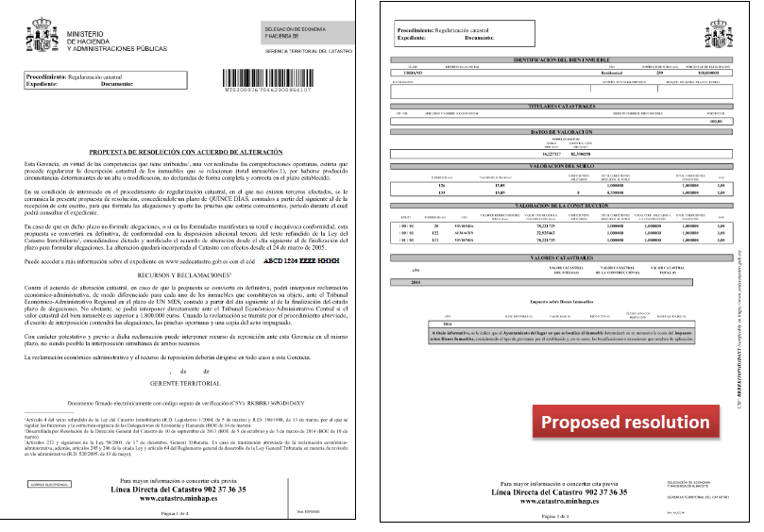

Slide 32
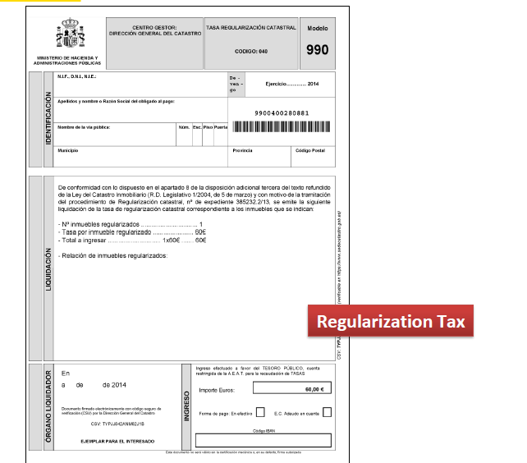
Regularization fee

Slide 33
The regularization agreement (appealing is possible )
The leaflet of the resultant property description
The explanatory sheet with the information of :
the changes produced (for contrast of previous and later situation);
previous and later cadastral values;
and graphic annex (photo and cartography);
2

Slide 34
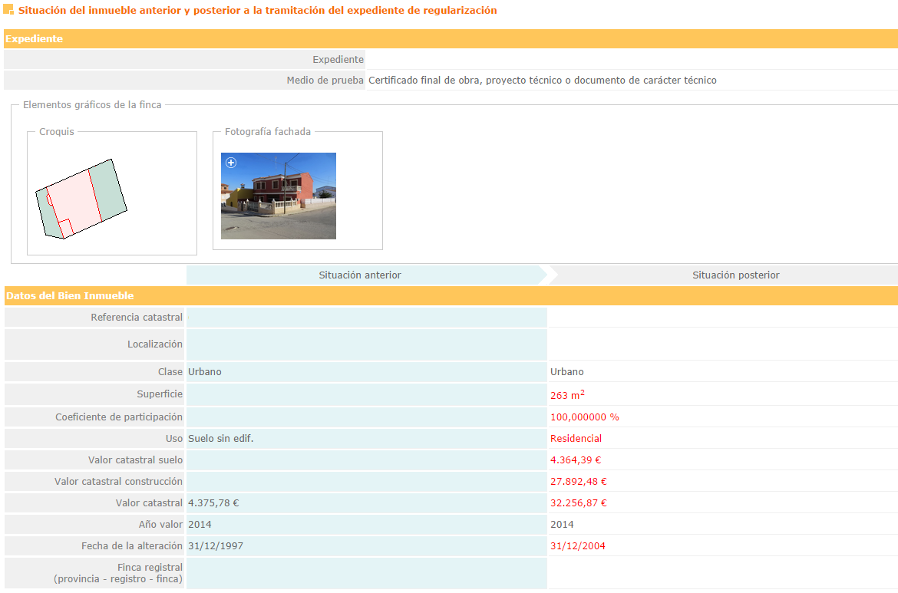

Slide 35
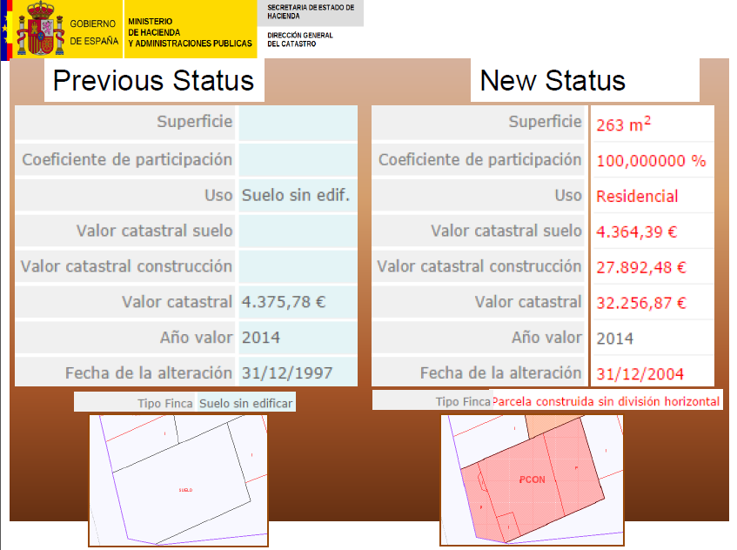

Slide 36
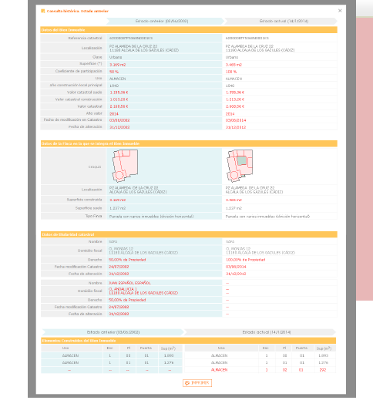
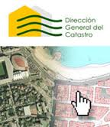
We also notify to the owners by mail a safe verification code which allows them to view in the cadastral virtual office the previous and posterior situation and other information
Also with this safe verification code they can present allegations and appeals

Slide 37

In 2014, the regularization procedure has been completed in 941 municipalities
More than 11 million urban real estate and 10 million rustic parcels have been verified.
More than 2,5 million photos has been obtained

Slide 38
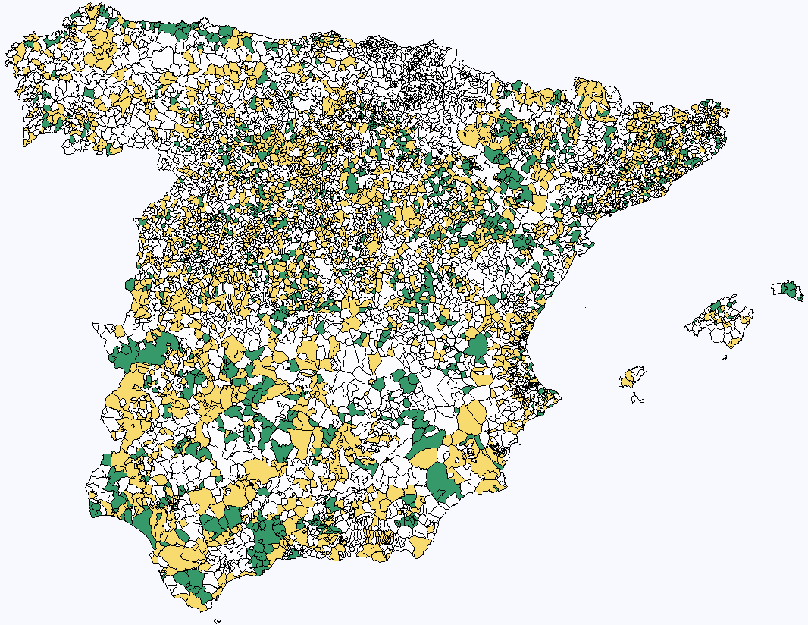
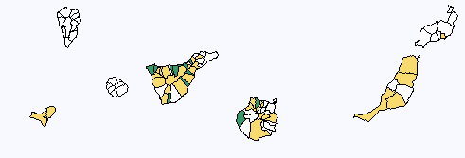
January 2015
Working in 15 MILLONES DE INMUEBLES URBANOS Y 14 MILLONES DE PARCELAS RÚSTICAS
941
2.270
3.211 MUNICIPIOS

Slide 39
Conclusions
Spanish Cadastre is performing this ambitious plan with success
Is improving the quality of the cadastral data base of buildings
Is accepted by the citizens
Is fighting against real estate tax fraud
and is helping to boost local finance
          Of course with a lot of work!!!!!
We are convinced that this proceeding help to remember the citizens the obligation to declare to the cadastre
and we hope never need to do a plan like this again

Slide 40
Thank you for your attention

